Slide 1
Goals of masculinities studies
Module 1, Session 3

Slide 2
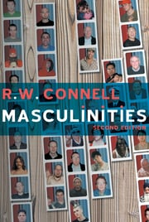
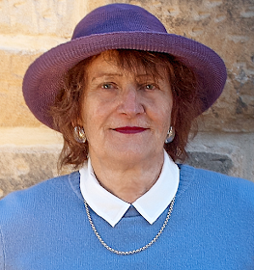
Goals of Masculinities Studies
To democratize gender relations, abolish power differentials, not to reproduce hierarchy
Why should men not defend patriarchy?
may not lead to satisfying lives
committed in important ways to women and may want better lives for them
Change in gender relations is taking place anyway, therefore no point in clinging to past privileges
Raewyn W. Connell (Masculinities, 1995)
oppression of gays
University of Sydney

Slide 3
Goals of Masculinities Studies
Supporting women’s reproductive rights and freedom of choice on abortion
Challenging homophobia
Developing a gay-affirmative culture
Developing anti-sexist initiatives in educational system
Recognition of diversity
Not supporting men’s violence
M. Kaufman (1993). Beyond patriarchy: Essays by men on power, pain, and the lives of men

Slide 4
Goals of masculinities studies : Men-as-partners in socio-economic development
Visibility to men’s involvement in gender equality since 1980s in international development forums
Some landmark events:
Fourth World Conference on Women in Beijing (1995) acknowledged men’s participation in promoting gender equality
World Summit on Social Development (1995/2000) addressed role of men and boys in Gender equality and in preventing HIV/AIDS and other diseases.
Involving men in gender equality mentioned in MDGs (2000) and SDGs (2015) adopted by UN

Slide 5
Men-as-partners in Indian context
Social reform movements in 19th c India
Characterized by male reformers who spoke up for women’s education, widow remarriage, abolishing of sati -- exemplars of supportive practices
But this attention to “women’s issues” was agenda within larger debates on modernity and nationalism
Post-independence
Emergence of the women’s movement in 1970s
Women themselves were marginal to the discourse
Role of men in enabling gender equality being recognized in development literature

Slide 6
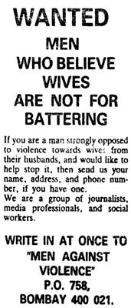

Some examples of organizations involving men for prevention of VAWC
Community mobilization for prevention of violence in Uganda since 1999, now used in over 20 countries.
Walks communities through process of change, unpacking power
Appeal by journalist C. Gopinath in Indian Express in 1991 made about 200 people come together and thus was born Men Against Violence and Abuse (MAVA) in Mumbai

